Slide 1
Abstraction

Slide 2

How much
Abstraction
?
Notes:
So, now that we have a little understanding of Abstraction, can we start to quantify it, can we ask how abstract is a piece of artwork, or how much art in the History of Art is abstract?

Slide 3
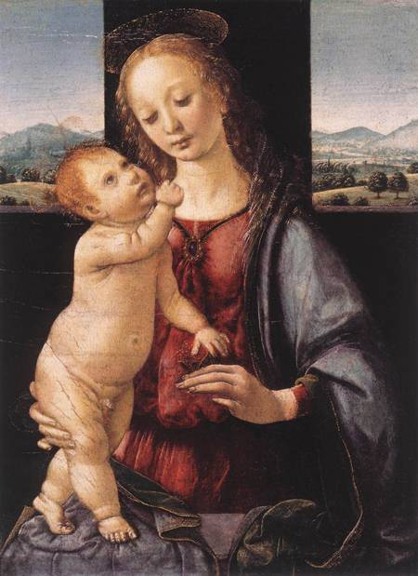
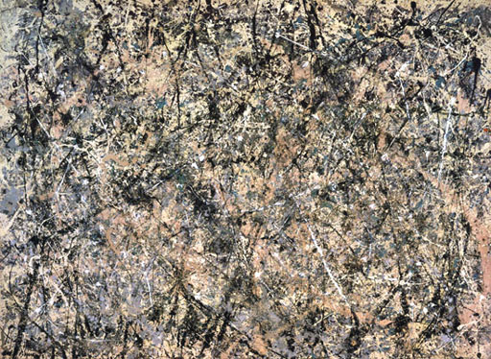
Notes:
Even if you're not completely confident about what abstraction is, I'm guessing you would still tell me the painting on the left is realistic, and the one on the right is abstract.

Slide 4
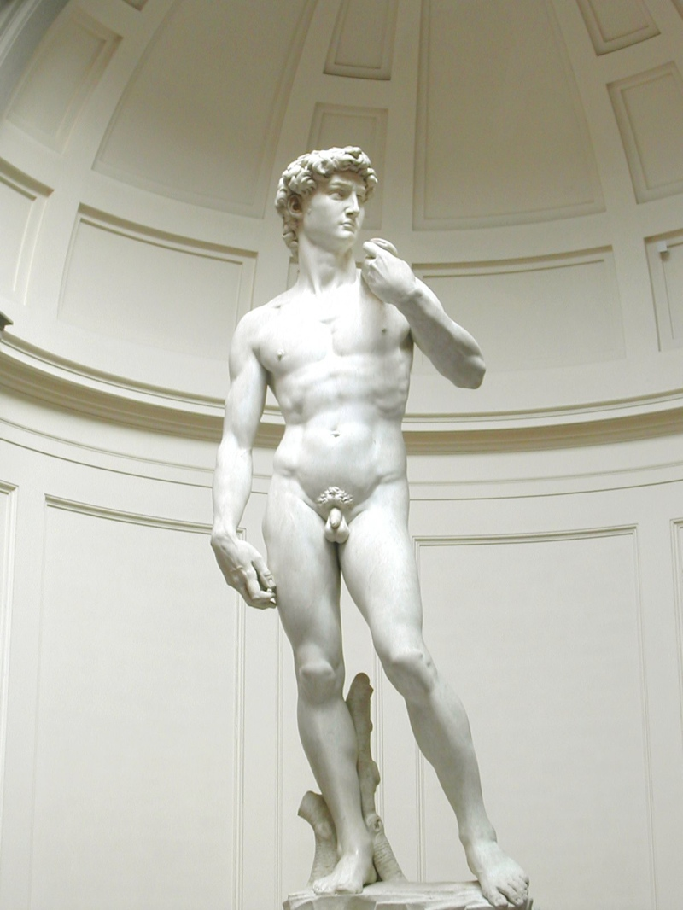
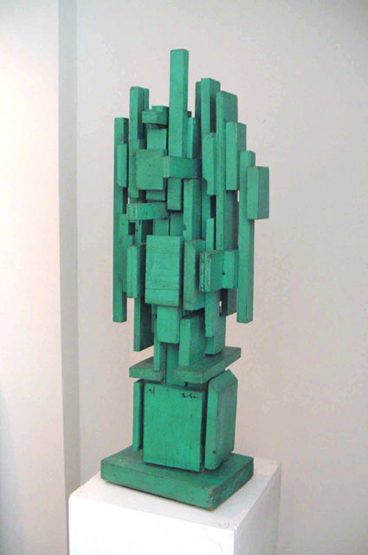
Notes:
And same with these two sculptures, I'm pretty sure everyone would agree that the one on the left is realistic and the one on the right is abstract.

Slide 5
REALISM
ABSTRACTION
Notes:
So, since not all artwork fits neatly into pure Abstraction and pure Realism, and it might be easier to imagine a spectrum between these two.

Slide 6
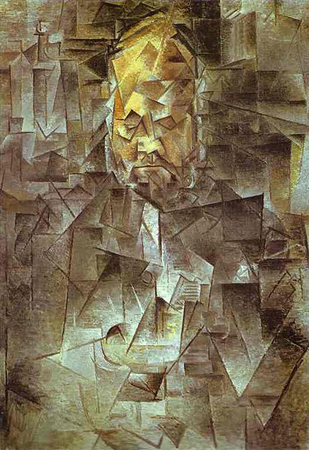
REALISM
ABSTRACTION
Notes:
And you could probably decide on a specific place for every piece of art on this spectrum.

Slide 7
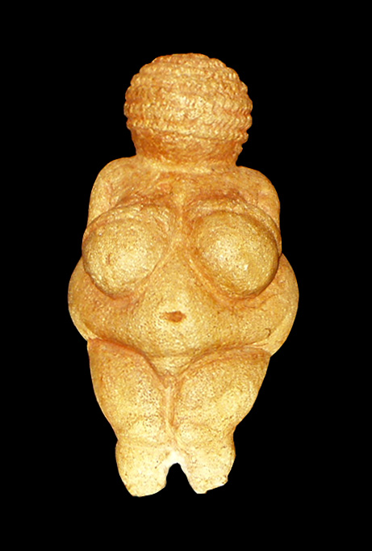
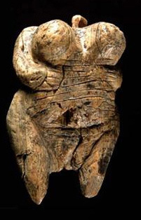
REALISM
ABSTRACTION
Notes:
And even argue that of any two pieces one is more or less abstract than another.

Slide 8
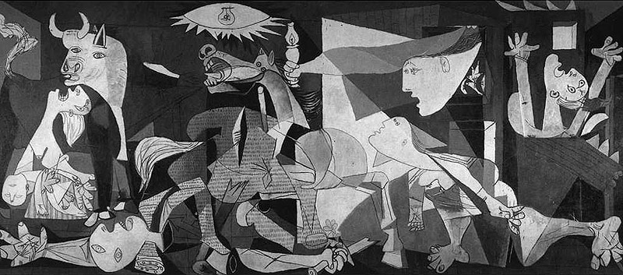
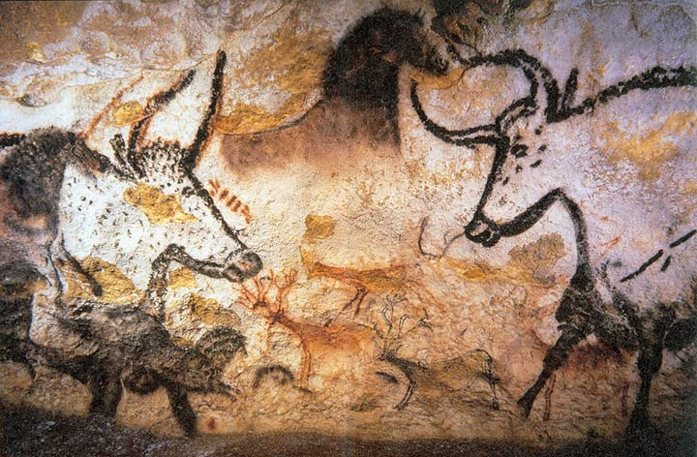
REALISM
ABSTRACTION
Notes:
We can also take two artworks from very different time periods and say they have perhaps the same or similar level of abstraction. Compare Picasso's Guernica with the cave paintings from Lascaux and notice the similar abstract composition of bulls and horses, even though there is over 17,000 years of history between them.

Slide 9
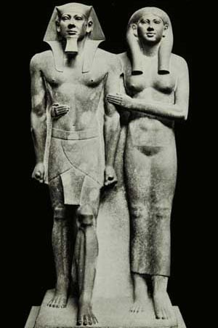
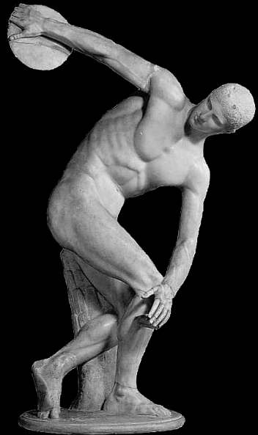
ART HISTORY (SO FAR)
Today
35,000 years ago
-20k
-16k
-4.5k
-2.5k
-1k
-60
-100
-500
Notes:
If we stretch the history of art out in a timeline we can maybe begin to start calling certain time periods a "Time of Abstraction" and other time periods "A Time of Realism". Around 4 1/2 thousand years ago the Egyptians started creating very realistic portraits of men and women and this continued on through the Renaissance to ever more realistic depictions of humanity.

Slide 10
ART HISTORY (SO FAR)
Today
35,000 years ago
-20k
-16k
-4.5k
-2.5k
-1k
-60
-100
-500
Notes:
If we tried to draw a line, and call certain time periods a "Time of Abstraction" and other time periods "A Time of Realism"...

Slide 11
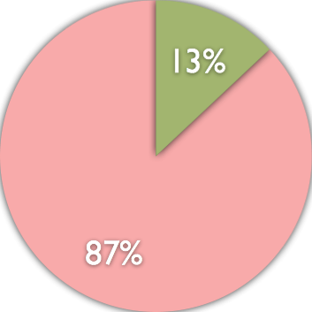
ART HISTORY (SO FAR)
Today
35,000 years ago
-20k
-16k
-4.5k
-2.5k
-1k
Time of realism
Time of abstraction
Notes:
...one surprising thing is that we find the "Time of Realism" is actually a very short amount of time in the history of art, only about 13% of recorded Art History.

Slide 12
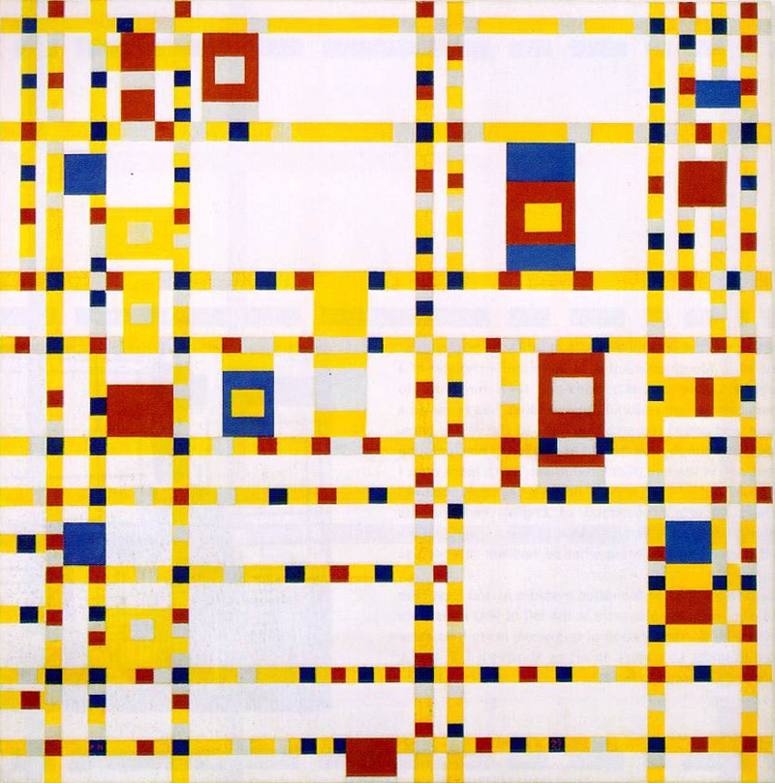
Notes:
So when we look at abstract art, maybe we're not looking so much at some strange modern break from the past, but rather a return to the normal state of art.

Slide 13
Images:
Venus of Hohle Fels, 35-40 thousand years old, Mamoth Ivory, Germany
Venus of Willendorf, 24-26 thousand years old, limestone
Lascaux Caves, 16 thousand years old, France
King Mycerinus and Wife, 4,500 years old, Egypt
Discobolus, 2,500 years old, Greece
Leonardo Da Vinci, Madonna and Child with a Pomegranate, 1469, Italy
Michelangelo, David, 1501-1504, Italy
Picasso, Vollard, 1910, France
Picasso, Guernica, 1937, Spain
Piet Mondrian, Broadway Boogie Woogie, 1940
Jackson Pollock, Lavender Mist, 1950, New York
Louise Nevelson, Untitled, 1950, painted wood, New York
Notes:
Venus of Hohle Fels, 35-40 thousand years old, Mamoth Ivory, Germany
Venus of Willendorf, 24-26 thousand years old, limestone
Lascaux Caves, 16 thousand years old, France
King Mycerinus and Wife, 4,500 years old, Egypt
Discobolus, 2,500 years old, Greece
Leonardo Da Vinci, Madonna and Child with a Pomegranate, 1469, Italy
Michelangelo, David, 1501-1504, Italy
Picasso, Vollard, 1910, France
Picasso, Guernica, 1937, Spain
Piet Mondrian, Broadway Boogie Woogie, 1940
Jackson Pollock, Lavender Mist, 1950, New York
Louise Nevelson, Untitled, 1950, painted wood, New York

